Slide 1

Simulation Theory
I hope you don’t think that I have truly gone mad.
The Simulation Theory or hypothesis focuses on the fact that there is a 0.00000000001 percent or less chance that we are in a simulation and if that argument is true then whether we can prove it or not.
We are trying to do the same thing over here which I will explain you in next 15 minutes

Slide 2
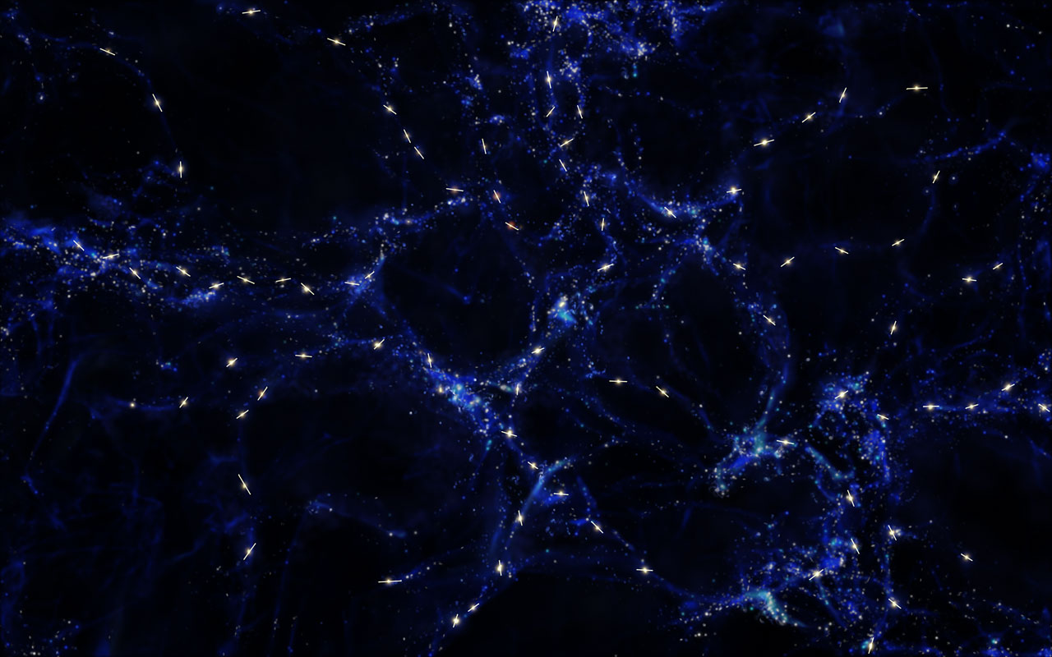
illustris Project
The original Illustris project was carried out by Mark Vogelsberger and collaborators as the first large-scale galaxy formation application of Volker Springel's novel Arepo code
The Illustris project includes large-scale cosmological simulations of the evolution of the universe, spanning initial conditions of the Big Bang, to the present day, 13.8 billion years later. Modeling, based on the most precise data and calculations currently available, are compared to actual findings of the observable universe in order to better understand the nature of the universe, including galaxy formation, dark matter and dark energy.

Slide 3
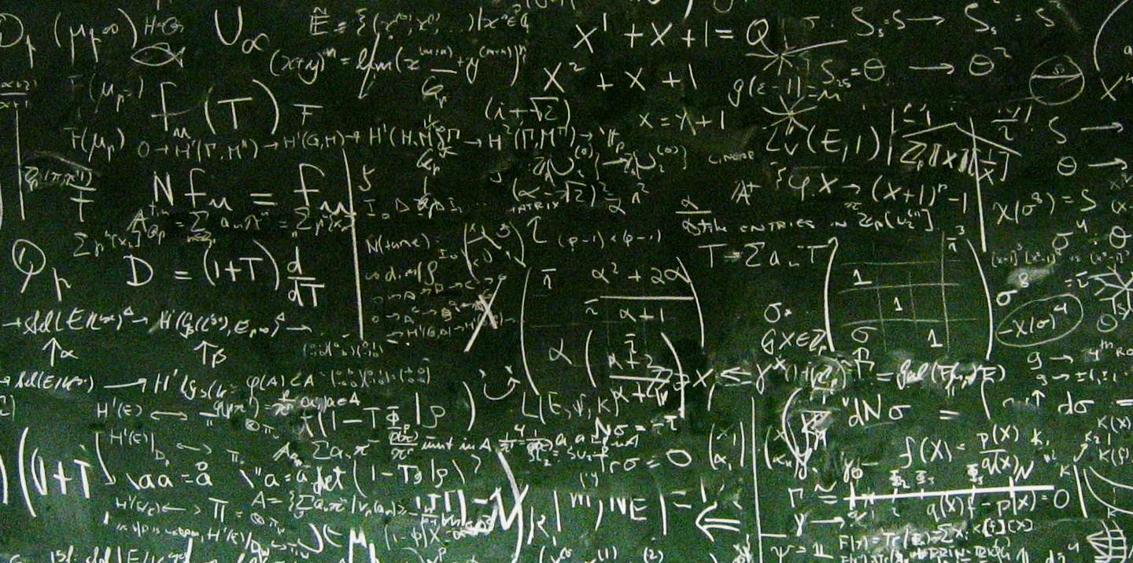
Universal Patterns
Patterns in nature are visible regularities of form found in the natural world. These patterns recur in different contexts and can sometimes be modelled mathematically. Natural patterns include symmetries, trees, spirals, meanders, waves, foams, tessellations, cracks and stripes. Early Greek philosophers studied pattern, with Plato, Pythagoras and Empedocles attempting to explain order in nature. The modern understanding of visible patterns developed gradually over time.
British mathematician Alan Turing predicted mechanisms of morphogenesis which give rise to patterns of spots and stripes. Hungarian biologist Aristid Lindenmayer and French American mathematician Benoît Mandelbrot showed how the mathematics of fractals could create plant growth patterns.

Slide 4

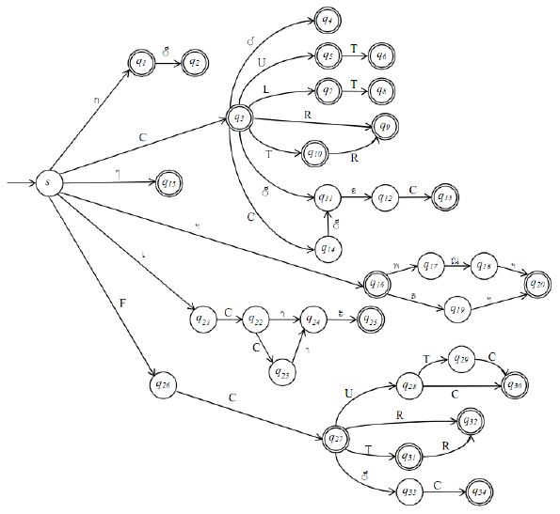
Randomness in Universe
In order to make something non deterministic randomness must exists so that we can say this object can go in these possible states hence it not controlled or governed by natural rules sadly Radom number don’t exist either in nature or in our computer technology hence pattern exists and where pattern exist predictability exist and where predictability exists patterns and structure exists.
No matter how difficult detection of pattern it is theoretically possible

Slide 5

Matbot Decoder
This software is actually in its infancy state but here is what we have done so far
Its Language Independent
CMD Based Software
Easy Project General Information Metrics
Built-in Regex Support
Built-in Language parsing Support
Highly Customized ML Model training support
Auto Generated UML Diagrams
Code Smells Detection Supported
Multiple filters and Code History
Reality Decoding Plugin Developed to Directly feed data to our Software
Code Learning Model that would become better and better in understanding code as time passes

Slide 6
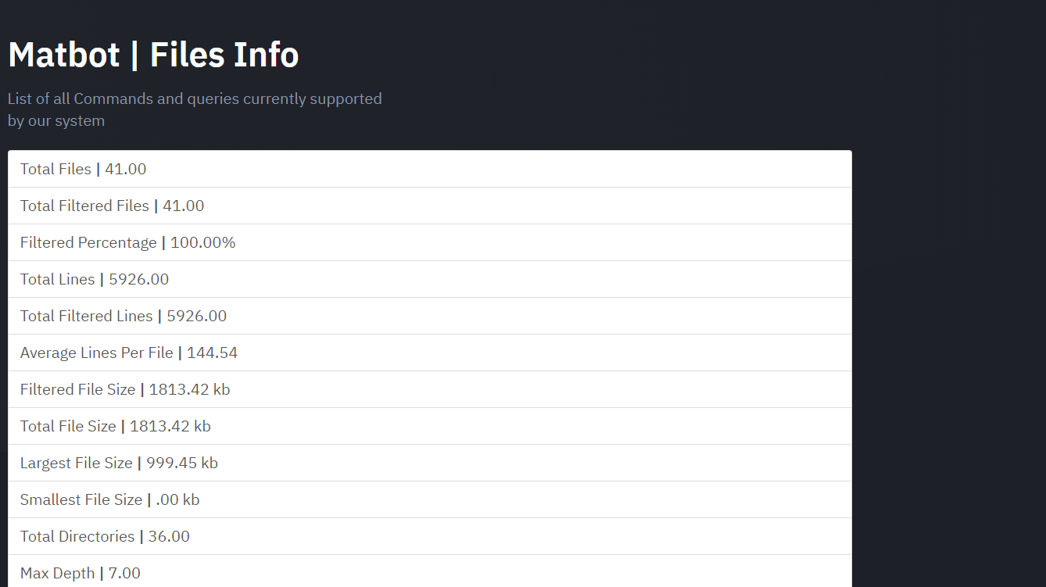
General Metrics

Slide 7
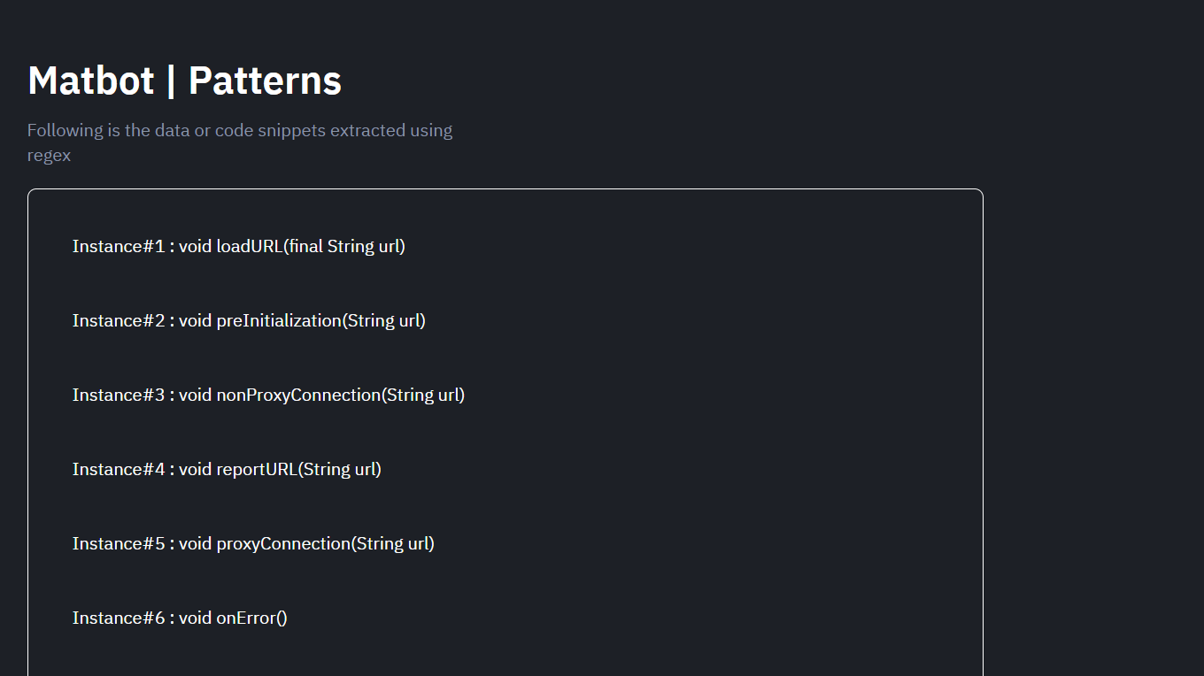
Regex Patterns

Slide 8
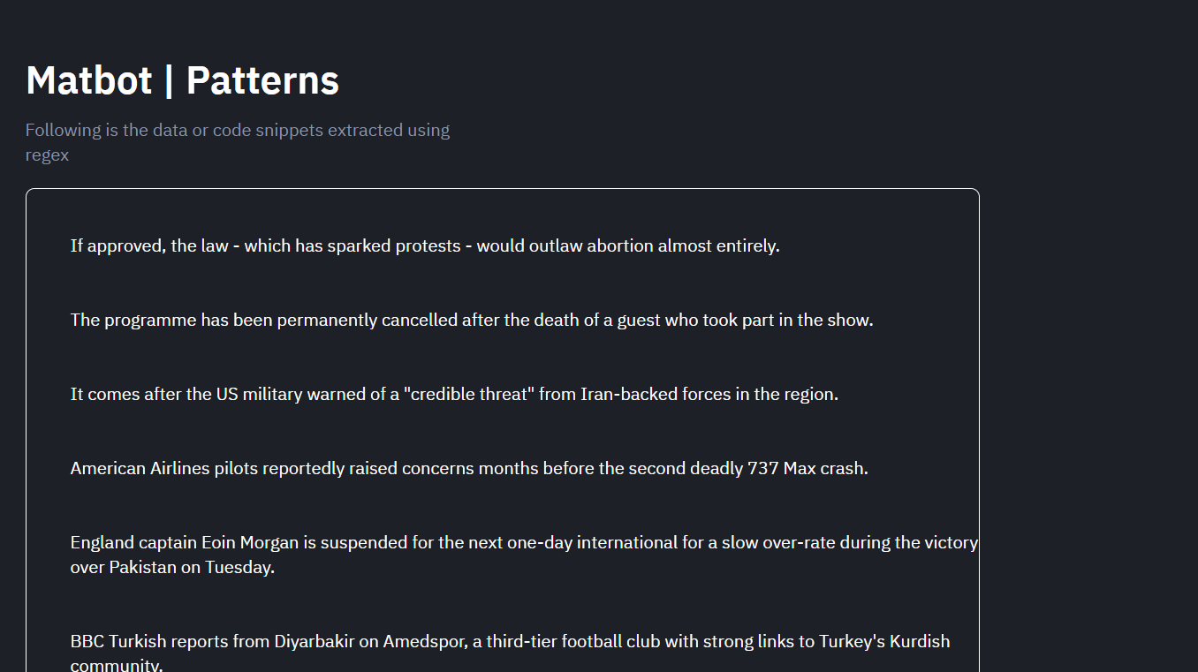
Parsing Extraction

Slide 9
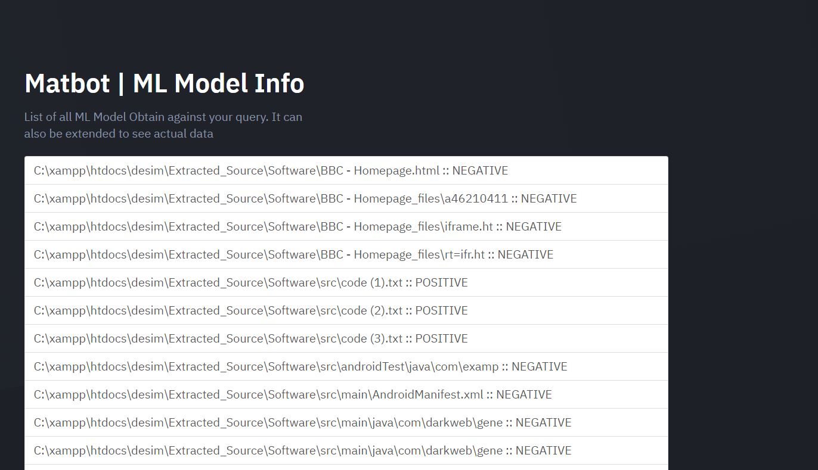
Machine Learning Model

Slide 10

Machine Learning Trainer

Slide 11
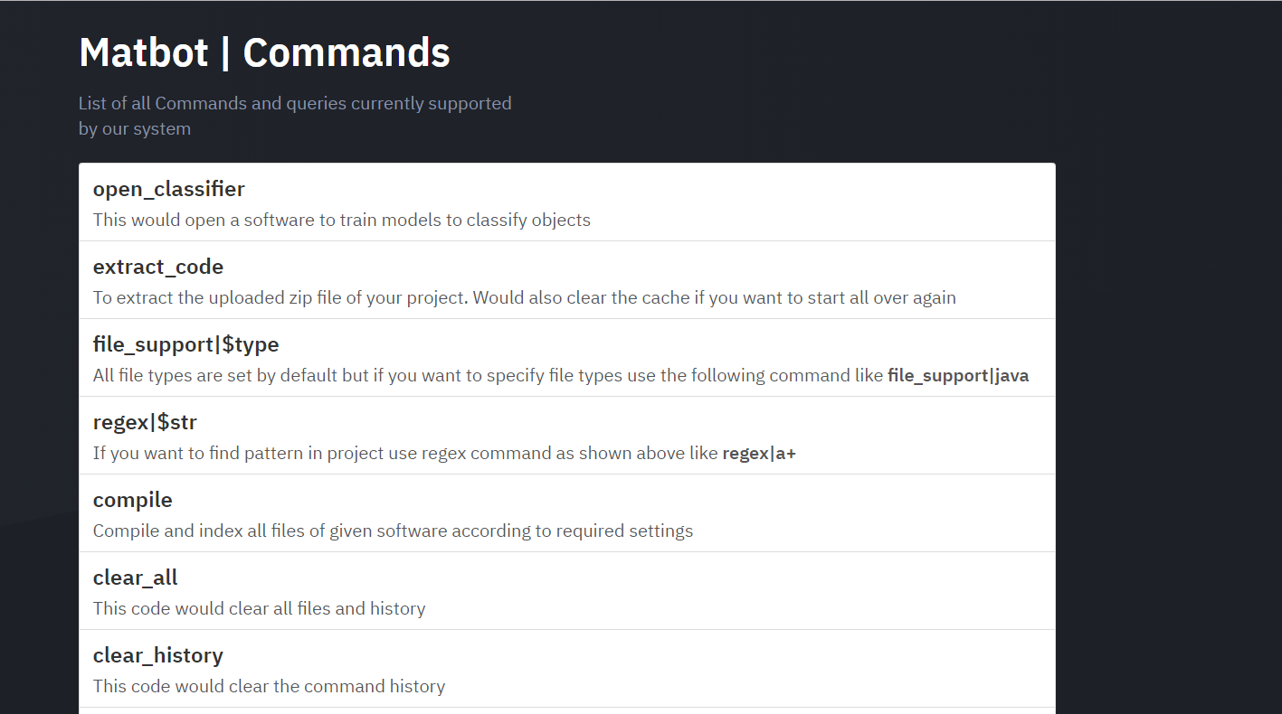
Supported Commands

Slide 12
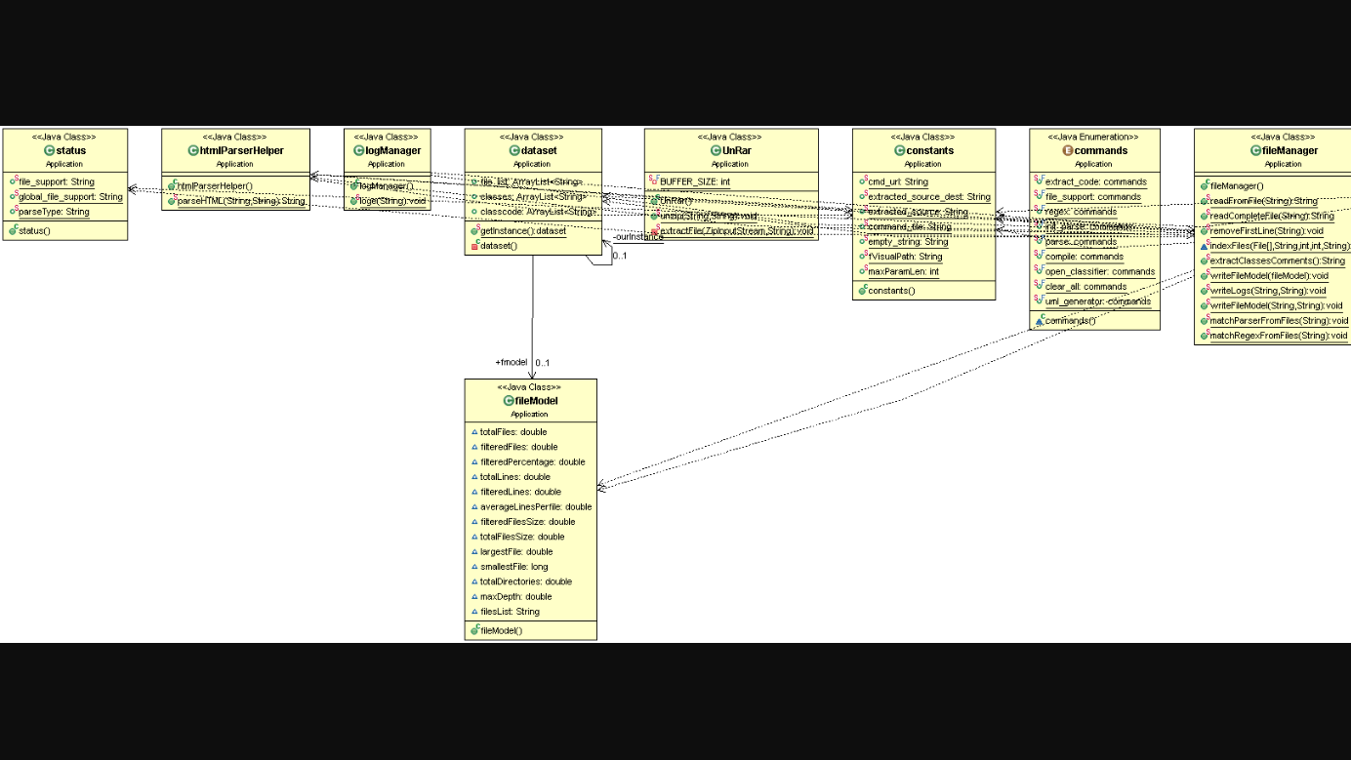
UML Support

Slide 13
Matrix Decoding

